Slide 1
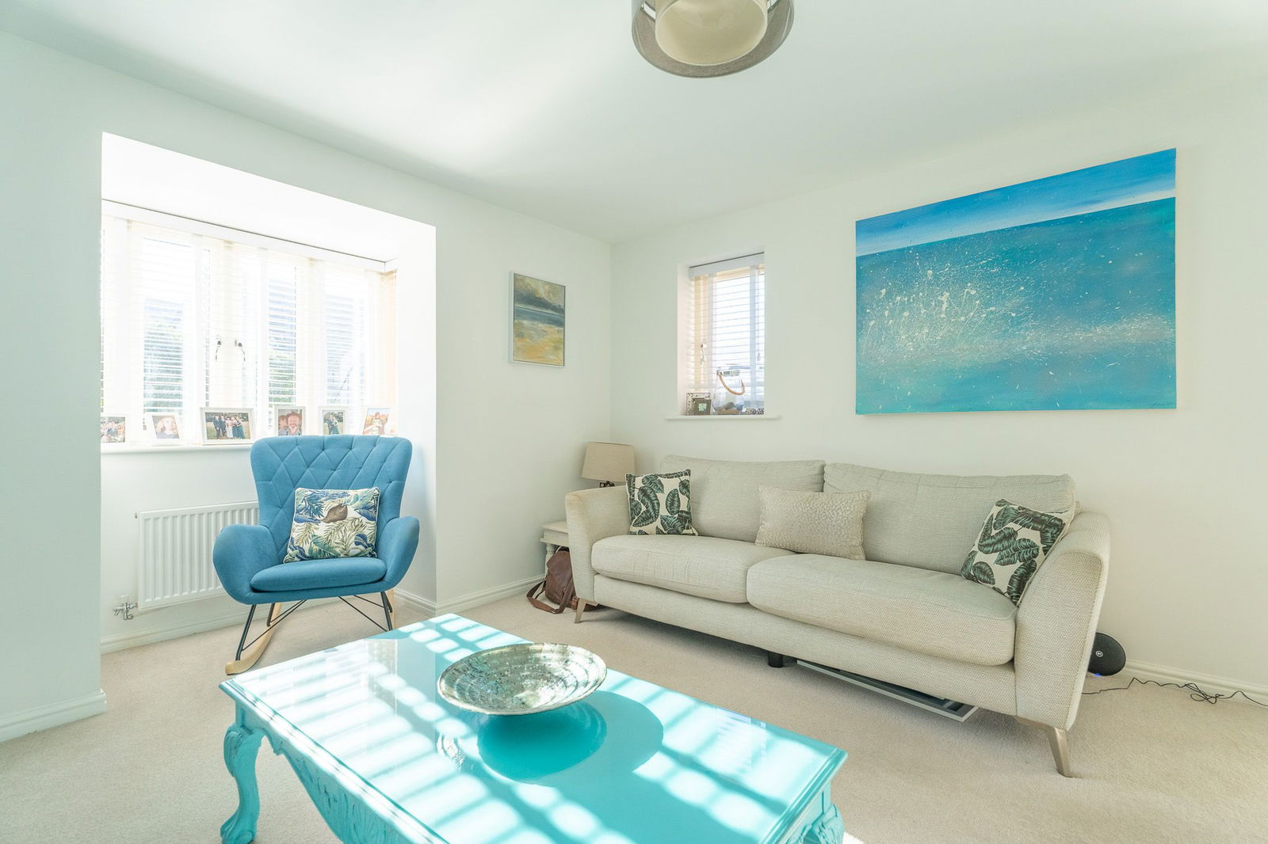
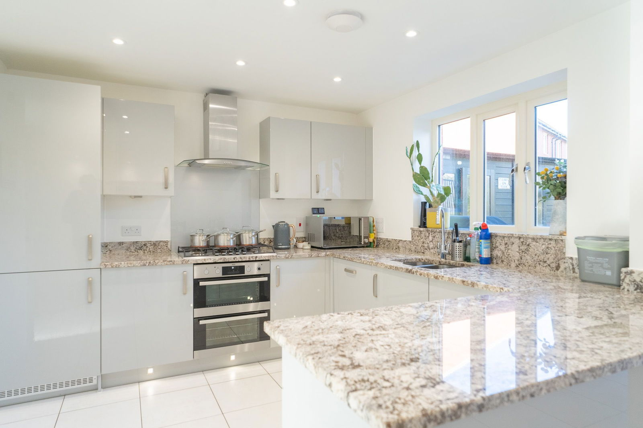
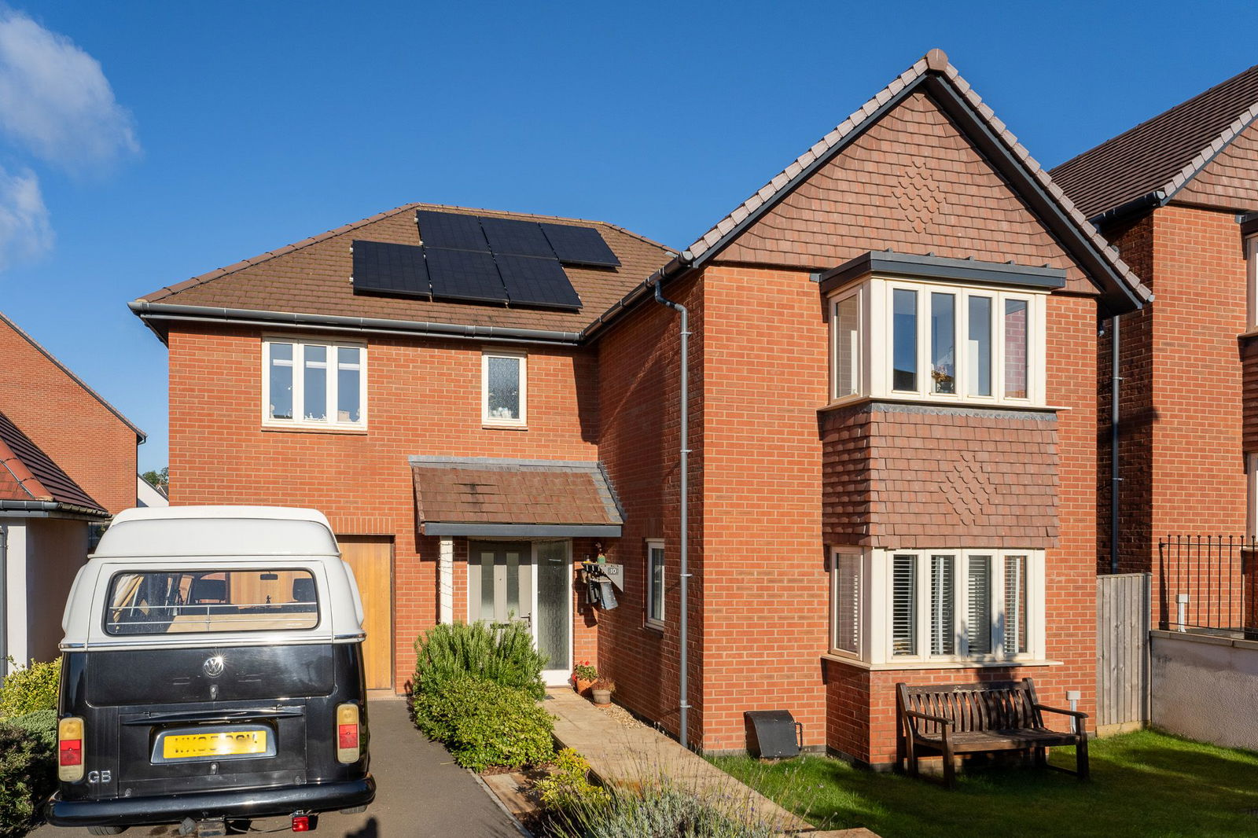
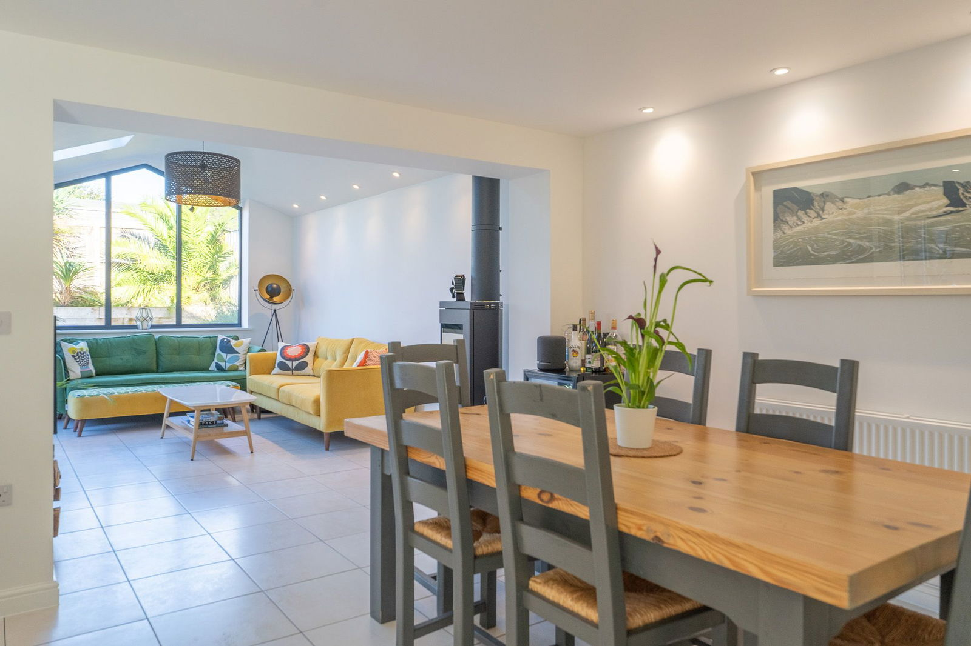
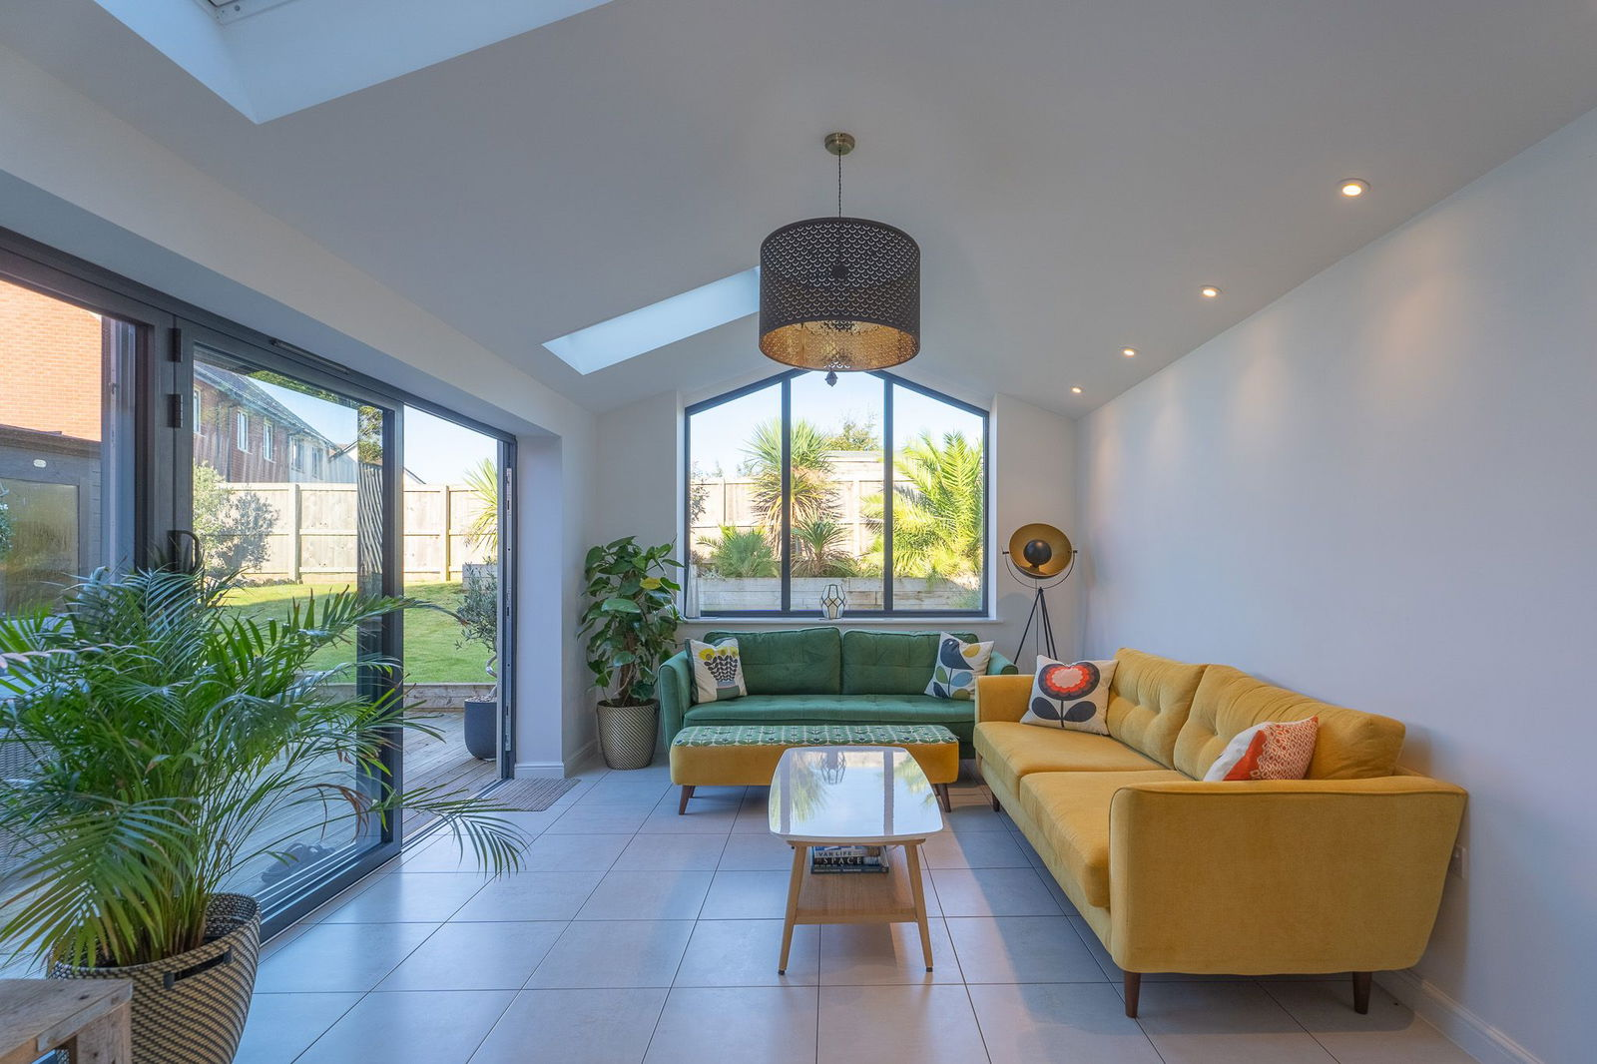
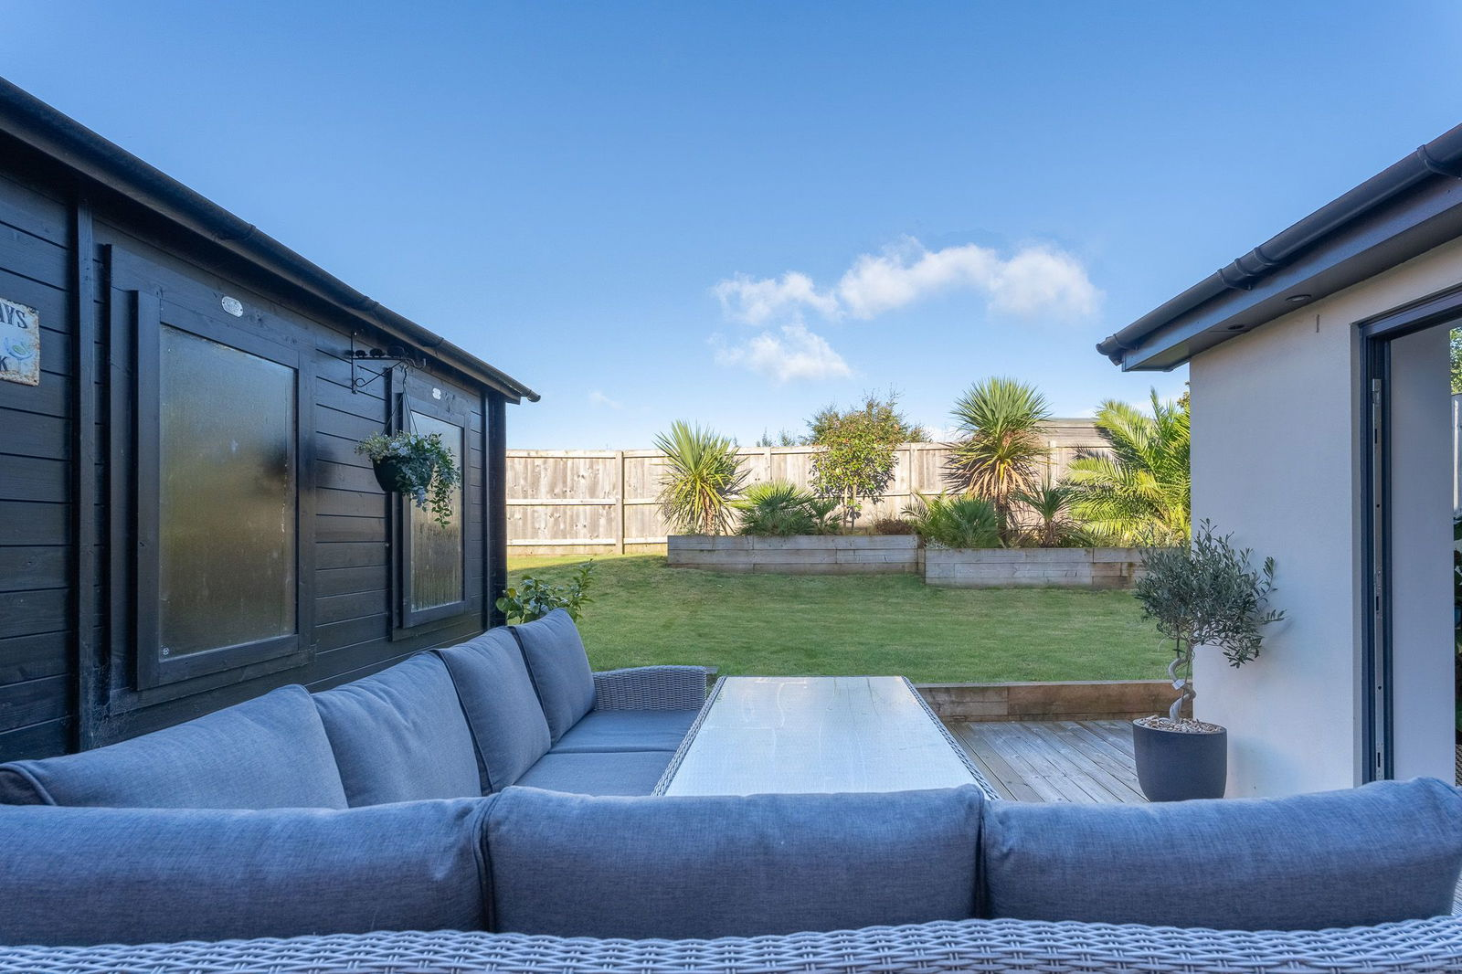
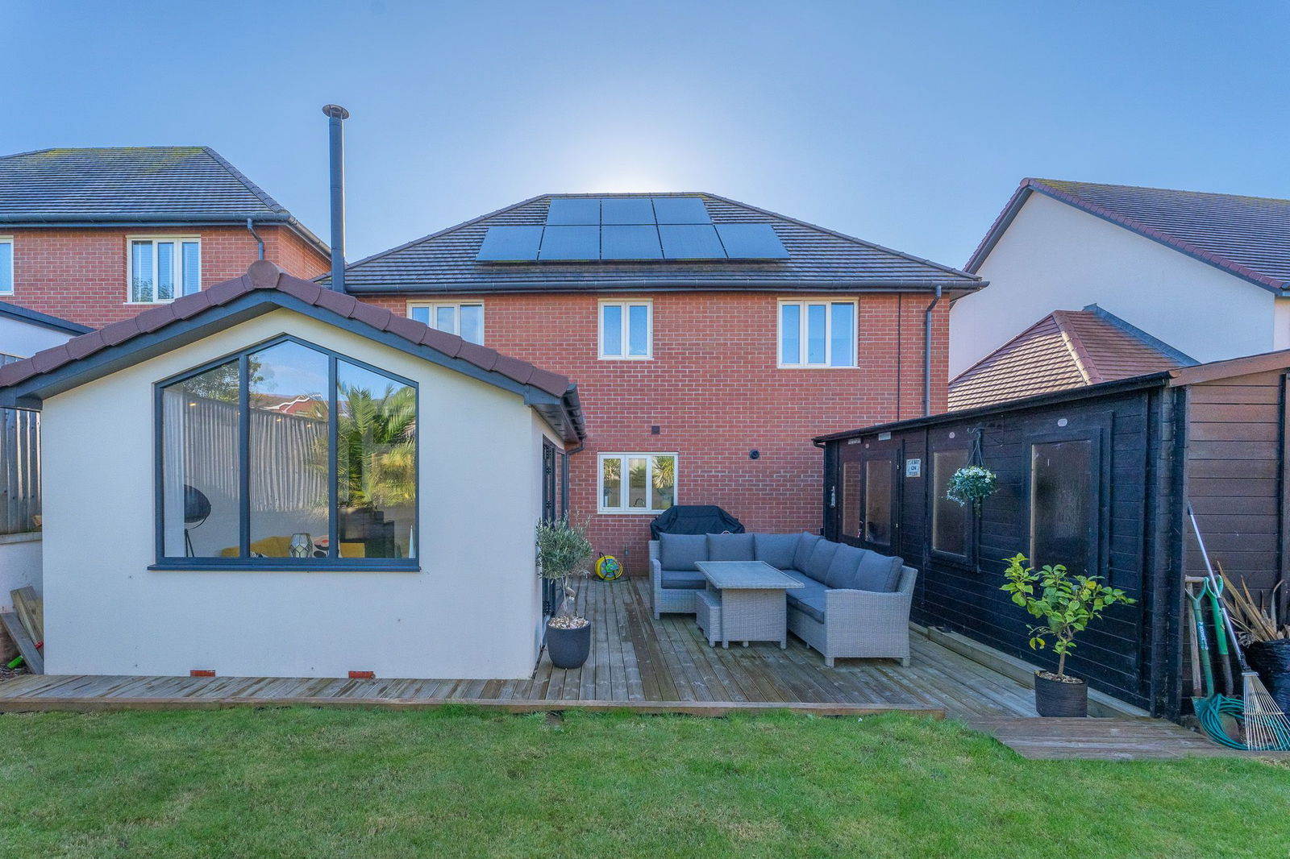
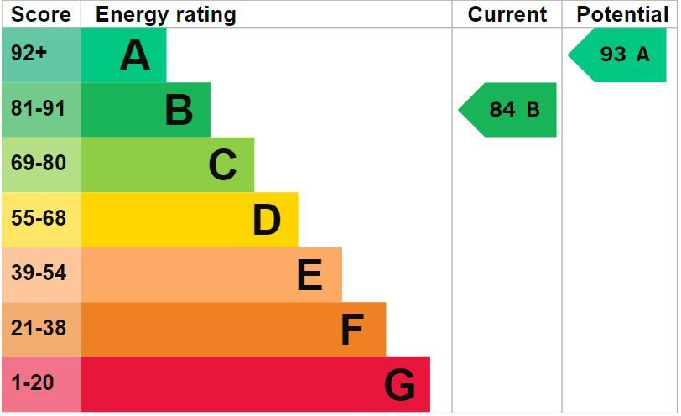
www.pennys.net
10 Lipscomb Avenue, Exmouth, EX8 2FL
GUIDE PRICE £675,000
TENURE Freehold
An Exceptionally Presented And Extended Four Bedroom Detached Family Style Residence Enjoying An Enviable Location On A Highly Desirable Development With Off-Road Parking, Garage And Attractive Landscaped Gardens
Pillared Entrance Canopy & Reception Hall • Dual Aspect Lounge • High Quality Kitchen/Breakfast Room/Dining Room • Stunning Family Room Extension •
Family Bathroom/WC • Ground Floor Cloakroom/WC •
Attractive Landscaped Rear Garden & Log Cabin • Driveway & Garage •
Viewing Highly Recommended •
Pennys Estate Agents Limited for themselves and for the vendor of this property whose agents they are give notice that:- (1) These particulars do not constitute any part of an offer or a contract. (2) All statements contained in these particulars are made without responsibility on the part of Pennys Estate Agents Limited. (3) None of the statements contained in these particulars are to be relied upon as a statement or representation of fact. (4) Any intending purchaser must satisfy himself/herself by inspection or otherwise as to the correctness of each of the statements contained in these particulars. (5) The vendor does not make or give and neither do Pennys Estate Agents Limited nor any person in their employment has any authority to make or give any representation or warranty whatever in relation to this property.
PENNYS ESTATE AGENTS
2 Rolle House, Rolle Street, Exmouth, Devon, EX8 2SN
Tel: 01395 264111 EMail: help@pennys.net

Slide 2
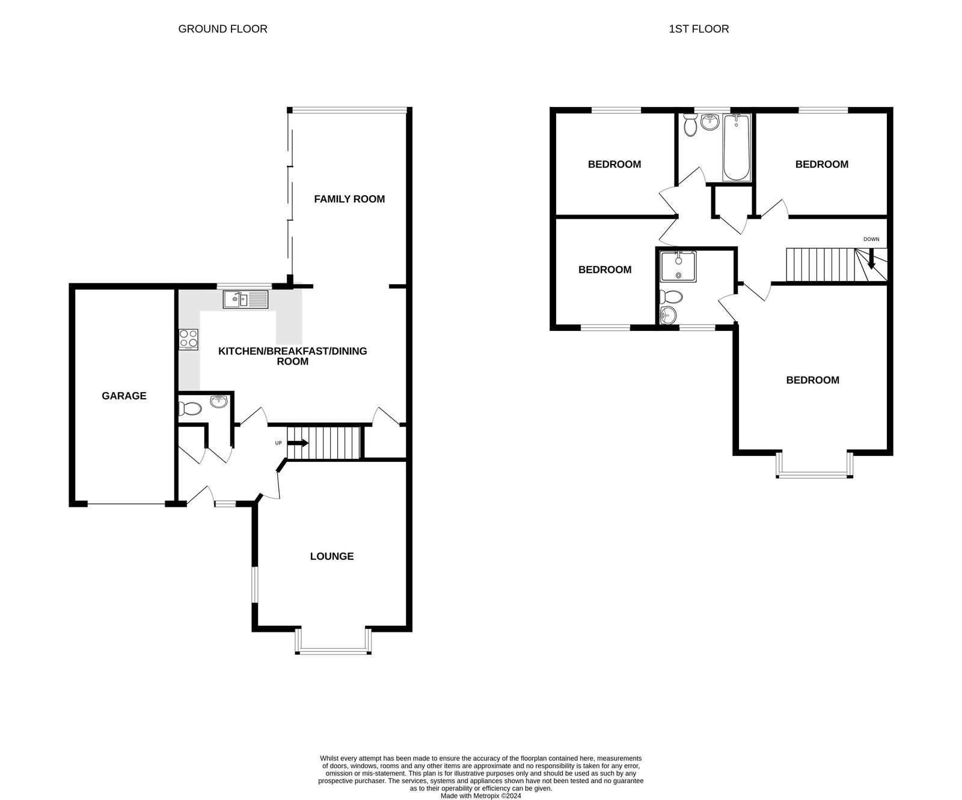
10 Lipscomb Avenue, Exmouth, EX8 2FL
Pennys are delighted to offer for sale this executive style detached residence which forms part of a newly built desirable development. The accommodation is found in superb order and has been improved further by the creation of a family room extension. Built by Messers Taylor Wimpey to a high standard approx. 5 years ago, the remainder of a 10 year guarantee. Outside there is beautifully landscaped gardens, driveway parking and garage. Viewing of this high quality home is strongly recommended. PILLARED ENTRANCE CANOPY: Composite front door with obscure glass inset and matching picture window to side leading to: RECEPTION HALL: Radiator; porcelain floor tiles; cupboard housing electric consumer unit & electric meter with shelving; stairs rising to FIRST FLOOR LANDING; thermostat control for central heating; doors to: GROUND FLOOR CLOAKROOM/WC: 1.63m x 1.14m (5'4" x 3'9") Comprising of WC with push button flush; space saver pedestal wash hand basin with chrome mixer tap; extractor fan; chrome heated towel rail; porcelain tiles; extractor fan. LOUNGE: 4.93m x 4.04m (16'2" x 13'3") measurement into bay. A most attractive room with wooden double glazed square bay window overlooking the front aspect and further wooden double glazed window to side aspect both with fitted blinds; two radiators; carpet; television point. KITCHEN/BREAKFAST ROOM/DINING ROOM: 6.5m x 3.84m (21'4" x 12'7") A high quality kitchen fitted with marble granite worktop surfaces with inset stainless steel one and a half bowl sink unit with chrome swan mixer tap over; range of gloss fronted base cupboards, drawer units and integrated washing machine beneath; integrated dishwasher; integrated upright fridge freezer; built-in electric oven and separate grill with 5 ring gas hob above and stainless steel chimney style extractor hood over with matching stainless steel splashback; wall mounted cupboards; LED ceiling spotlights; concealed under counter lighting; plinth lighting; carbon monoxide alarm; radiator; porcelain floor tiles throughout; wooden double glazed window overlooking the rear garden; understairs storage cupboard with shelving, coat rack and light connected; opening through to: FAMILY ROOM: 4.85m x 3.3m (15'11" x 10'10") A stunning addition to the property which has been added by the current owners, creating additional living accommodation on the ground floor with double glazed feature window overlooking the rear garden; two electric velux windows; feature Nordpeis wood burner; television point; porcelain floor tiles; LED ceiling spotlights; anthracite bi-folding doors opening onto REAR GARDEN. FIRST FLOOR LANDING: Wooden double glazed window to side aspect; access to partially boarded roof space; smoke alarm; airing cupboard housing hot water tank and slatted shelving; doors to: BEDROOM ONE: 4.9m x 4.01m (16'1" x 13'2") measurement into wooden double glazed square bay window overlooking the front aspect; radiator; thermostat control for upstairs central heating; door to: EN-SUITE SHOWER ROOM/WC: 2.18m x 1.98m (7'2" x 6'6") Comprising of shower cubicle with glass splash screen doors and rainfall shower with separate detachable hand held attachment; attractive part tiled walls; pedestal wash hand basin with mixer tap and tiled splashback; WC with push button flush; chrome heated towel rail; wood effect flooring; extractor fan; wooden double glazed window to front aspect with obscure glass. BEDROOM TWO: 4.06m x 3.23m (13'4" x 10'7") measurement into door recess. wooden double glazed window to front aspect; radiator. BEDROOM THREE: 4.09m x 2.87m (13'5" x 9'5") Wooden double glazed window to rear aspect with pleasant outlook; television point; radiator. BEDROOM FOUR: 3.35m x 2.87m (11'0" x 9'5") Wooden double glazed window to rear aspect overlooking the rear garden; radiator. FAMILY BATHROOM/WC: 1.98m x 1.88m (6'6" x 6'2") A stunning suite comprising of a bath with mixer tap and detachable hand held shower attachment and glass shower splash screen; attractive tiled walls; pedestal wash hand basin with chrome mixer tap; WC with push button flush; mirror fronted medicine cabinet chrome heated towel rail; extractor fan; wood effect flooring; wooden double glazed window with obscure glass.
OUTSIDE: To the front of the property there is a tarmac driveway providing off-road parking for numerous vehicles and access to the GARAGE. There is a cast iron gate leading to a patio pathway which leads to the front door, there is an attractive lawned garden which is edged with a range of mature shrubs, laurel hedges, decorative stones and flower borders. There is a patio pathway providing pedestrian access to the rear garden. The rear garden is an exquisite feature which comprises of a large decked area ideal for alfresco dining and outside entertaining, a lawn area which is edged with wooden sleepers planted with a range of flowers, shrubs and trees, decorative stone area edged with rockery and further raised decked area, outside tap, outside power sockets, access to: LOG CABIN/GARDEN ROOM: 5.31m x 3.3m (17'5" x 10'10") Windows and doors overlooking the rear garden; power and light connected; internet point; television point; wooden bar area. GARAGE: 6.25m x 2.97m (20'6" x 9'9") Up and over door; power and light connected; battery & inverter for solar panels. AGENTS NOTE: The property has solar panels and these are owned outright.
FLOOR PLAN:

